Slide 1


CHAPTER
The Global Environment
PowerPoint Presentation
by Charlie Cook
Copyright © by Houghton Mifflin Company.
All rights reserved.

Slide 2
Learning Objectives
After studying this chapter, you should be able to:
  Describe the nature of international business, including its meaning, recent trends, the management of globalization, and competition in a global environment.
  Discuss the structure of the global economy and how it affects international management.
  Identify and discuss the environmental challenges inherent in international management.
  Describe the basic issues involved in competing in a global economy, including organization size and the management challenges in a global economy.
Copyright © by Houghton Mifflin Company. All rights reserved.
5–<number>

Slide 3
Chapter Outline
The Nature of International Business
  The Meaning of International Business
  Trends in International Business
  Managing the Process of Globalization
  Competing in a Global Environment
The Structure of the Global Economy
  Mature Market Economies and Systems
  High Potential/High Growth Economies
  Other Economies
Copyright © by Houghton Mifflin Company. All rights reserved.
5–<number>

Slide 4
Levels of International Business Activity
Lowest
Level of International Activity
Highest
Domestic
International
Multinational
Global
business
business
business
business
Copyright © by Houghton Mifflin Company. All rights reserved.
Figure 5.1
5–<number>

Slide 5
The Meaning of International Business
Domestic Business
  acquires all of its resources and sells all of its products or services within a single country.
International Business
  is primarily based in a single country yet acquires a meaningful share of its resources and/or revenues from other countries.
Multinational Business
  transcends national boundaries and buys raw materials, borrows money, and manufactures and sells its products in a world-wide marketplace.
Global Business
  transcends national boundaries and is not committed to a single home country.
Copyright © by Houghton Mifflin Company. All rights reserved.
5–<number>

Slide 6
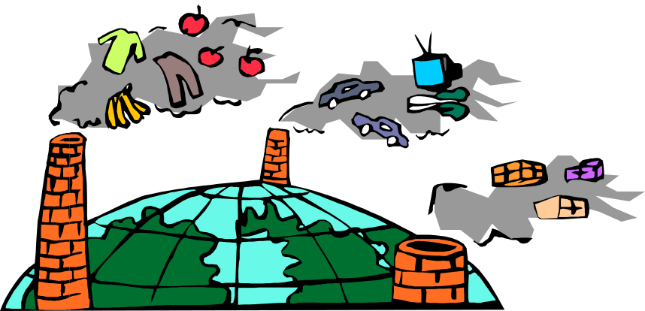
Trends in International Business
Economic Recovery
  Industrialized nations in Europe and Asia have rebuilt their economic systems that were devastated in WWII.
Decreasing Isolation from Foreign Competition
  U.S. consumer goods markets are open to overseas competitors.
Increasing Globalization of World Markets
  Volume of international trade has increased more than 3,000% from 1960 to 2000.
Copyright © by Houghton Mifflin Company. All rights reserved.
5–<number>

Slide 7
Managing The Process of Globalization
Exporting
  Making a product in the firm’s domestic market and selling it in another country.
Importing
  Bringing a good, service, or capital into a home country from abroad.
  Advantages are small cash outlay, little exchange risk, and no adaptation of product or service is necessary.
  Disadvantages are tariffs and taxes imposed on cross-border goods, high transportation costs to/from distant markets, and governmental restrictions and regulations.
Copyright © by Houghton Mifflin Company. All rights reserved.
5–<number>

Slide 8
Managing The Process of Globalization (cont’d)
Licensing
  Advantages are increased profitability from licensing without additional capital requirements, lower operational costs in foreign markets, and extended profitability from existing technologies.
  Disadvantages are inflexibility in the licensing arrangement, loss of profits from licensee failure, and licensing possibly helps competitors learn to compete.
Copyright © by Houghton Mifflin Company. All rights reserved.
5–<number>

Slide 9
Franchising: Franchising is a business model where a company (called the franchisor) allows an individual or another company (the franchisee) to operate a business using its brand name, products/services, and operating system in exchange for fees or royalties.
Advantages for the Franchisee:
Brand recognition
Lower risk than starting a new business
Training and support from the franchisor
Disadvantages for the Franchisee:
Less freedom in decision-making
Ongoing fees/royalties
Must follow strict operational guidelines
Copyright © by Houghton Mifflin Company. All rights reserved.
5–<number>

Slide 10
Strategic Alliance and Joint Ventures
  Advantages are quick market entry, access to materials and technology, and reduced risk.
  Disadvantage is that shared ownership limits control and profitability.
Copyright © by Houghton Mifflin Company. All rights reserved.
5–<number>

Slide 11
Managing The Process of Globalization (cont’d)
Direct Investment
  Advantages are enhanced operational control, it allows use of existing infrastructure, and no adaptation of in-country product or service is necessary.
  Disadvantages are complexity in managing a foreign operation, greater economic- and political-risk exposure, and greater uncertainty of business risk.
  Maquiladoras are light-assembly plants built in northern Mexico close to the U.S. border which are given special tax breaks by the Mexican government.
Copyright © by Houghton Mifflin Company. All rights reserved.
5–<number>

Slide 12
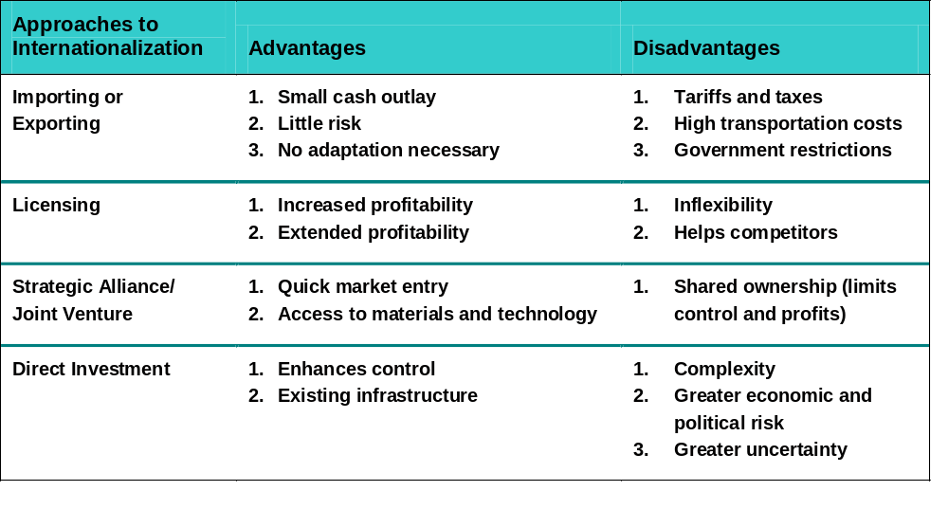
Advantages and Disadvantages of Different Approaches to Internationalization
Copyright © by Houghton Mifflin Company. All rights reserved.
Table 5.1
5–<number>

Slide 13

The Structure of the Global Economy
Market Economies and Systems
  Based on the private ownership of business and allows market factors such as supply and demand to determine business strategy.
  Characteristics are a mature economy, well-developed infrastructures, and individual wealth.
Market Systems
  Clusters of countries that engage in high levels
  of trade with each other through the elimination
  of trade barriers such as quotas and tariffs.
  North American Free Trade Agreement (NAFTA)
  covering the United States, Mexico, and Canada.
  European Union (EU) of western European countries.
  Pacific Asia countries in Southeast Asia.
Copyright © by Houghton Mifflin Company. All rights reserved.
5–<number>

Slide 14
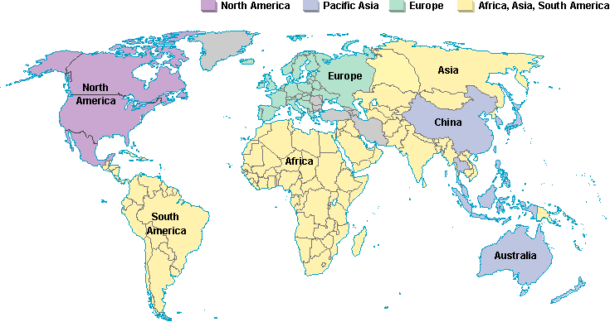
The Global Economy
The global economy is dominated by three relatively mature market systems
Copyright © by Houghton Mifflin Company. All rights reserved.
Figure 5.2
5–<number>

Slide 15

Market Economies and Systems
High Potential/High Growth Economies
  Characteristics are underdeveloped and immature markets, weak industrial base, weak currency, and poor consumers.
  People’s Republic of China, India, Vietnam, Brazil, Russia.
  Challenges to market development:
    The need for large investments in distribution systems.
    The need to educate/train consumers
    in product usage.
    A lack of infrastructure for
    support operations.
    Unfavorable policy changes
    affecting investments.
Copyright © by Houghton Mifflin Company. All rights reserved.
5–<number>

Slide 16

Market Economies and Systems (cont’d)
Other Economies
  Some economies defy classification due to their possession of critical and valuable resources (e.g., oil-producing countries) or other social or political factors which distort their internal economies and markets.
  Challenges of other economies
    Political instability
    Cultural differences
    Ethnic violence
Copyright © by Houghton Mifflin Company. All rights reserved.
5–<number>

